Slide 1
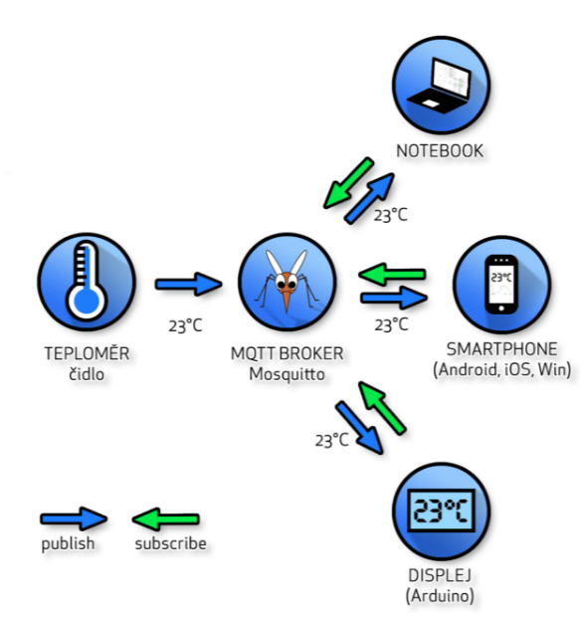
Message Queuing Telemetry Transport (MQTT)
Khamdamboy Urunov, a Ph.D. student. Special Communication Research Center., Graduate School of Financial Information Security., Kookmin University Seoul, South Korea

Slide 2
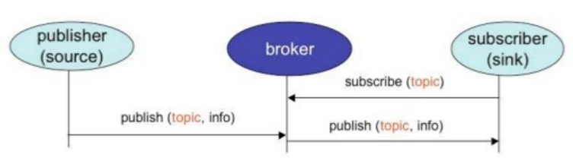
MQTT base architecture
Publisher and subscriber
Publisher→ publish (topic, info)
Subscriber → subscribe (topic)

Slide 3
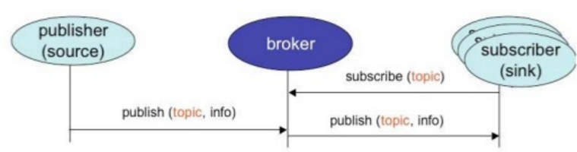
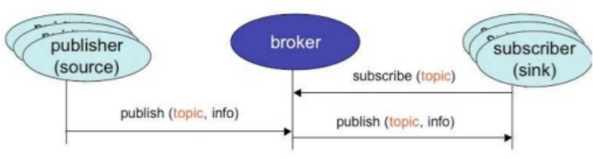
MQTT base architecture (cont…)
Million of subscribers
Million of publisher

Slide 4
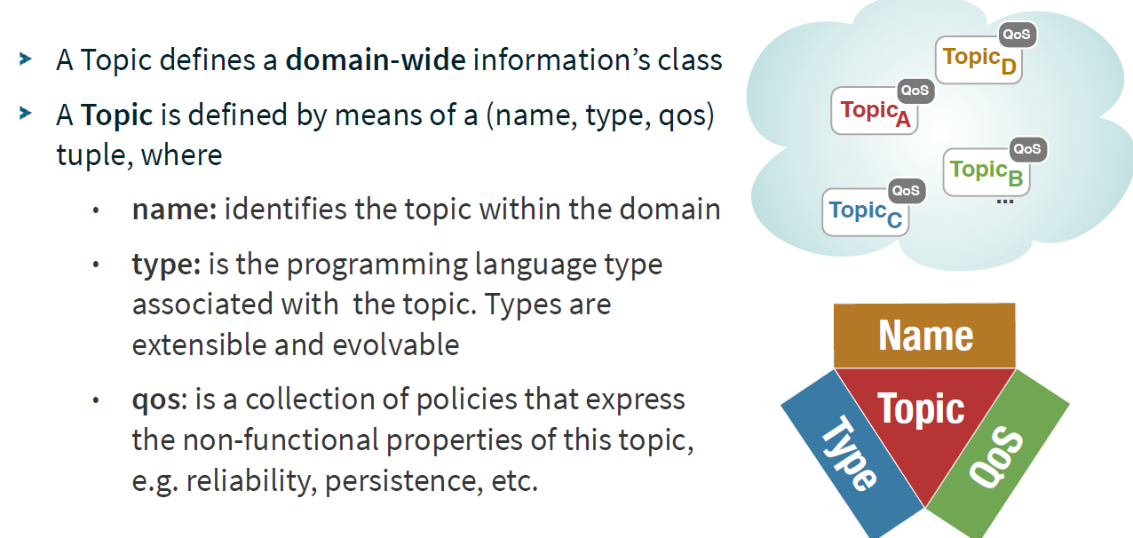
MQTT Topic

Slide 5
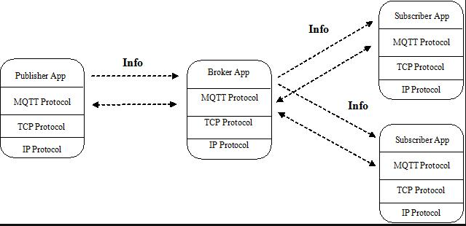
MQTT info and main parameters
Obviously, MQTT is built on TCP/IP and implement Publisher-Broker-Subscriber pattern.
It means one publisher can easily achieve multicast functionality.
Infrastructure in MQTT has three parts: * Broker Server. Basically, its job is to accept subscribers and re-transmit info from publisher to subscribers. In complex system, broker server can do more jobs related to data analysis and mining. * Subscriber Client. In most of time, it listens to broker after subscribing and ready for handling incoming message. * Publisher Client. In "Internet of Things" system, each device connected has the ability of sensor and can be triggered by events, which produces useful and important information to notify outside. If subscriber and publisher are both integrated in an app, then it can work in duplex mode, which can listen to and notify outside.
http://m2mcloud.blogspot.kr/

Slide 6
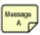
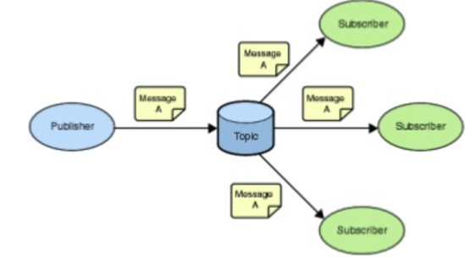
PubSub support Broadcast 1 – to- many
MQTT Data Distribution
publisher
Br
topic
PubSub support 1 – to- zero
publisher
Br
topic
subscriber
PubSub support 1 – to- 1

Slide 7
Open source code implementations MQTT & CoAP
CoAP
IP for Smart Objects Alliance
Specification
Open source implementations:
SourceForge
GitHub
Contiki
Browser plugin
REST
Standards working group
MQTT
Community website
Specification
Open source implementations:
Paho
Mosquitto
GitHub
Standards working group
http://www.eclipse.org/community/eclipse_newsletter/2014/february/article2.php

Slide 8
MQTT Message format
Fixed header
Message Type
Flags
Remaining Length
Variable header
Protocol name
Protocol version
Connect flags
Clean session flag
Will flag
Will QoS
Will Retain flag
User name and password flags
Keep Alive timer
Connect return code
Topic name
Payload
Message identifier
MQTT and UTF-8
Unused bits
Command Message
CONNECT
CONNACK
PUBLISH
PUBACK
PUBREC
PUBREL
PUBCOMP
SUBSCRIBE
SUBACK
UNSUBSCRIBE
UNSUBACK
PINGREC
PINGREST
DISCONNECT
Functions:
Fixed header
Variable header
Response
Payload
Actions
MQTT V3.1 Protocol Specification

Slide 9
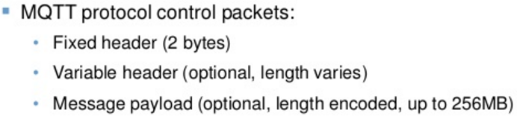
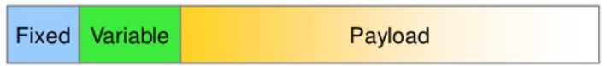
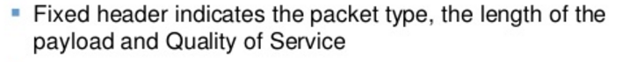
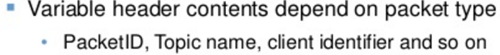
MQTT protocol details - Header
Fixed header
Message Type
Flags
Remaining Length

Slide 10
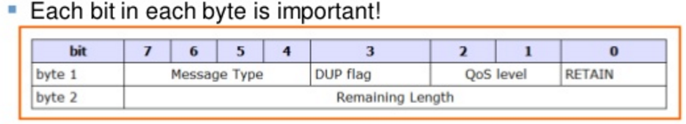
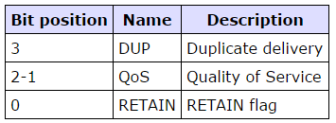
MQTT protocol details – Header (cont…)
Flags
The remaining bits of byte 1 contain the fields DUP, QoS, and RETAIN. The bit positions are encoded to represent the flags as shown in the table below.

Slide 11
MQTT Message format
Message type:
Message | 4- bit code | Description
CONNECT | 1 | Client request to connect to Server
CONNACK | 2 | Connect Acknowledgment
PUBLISH | 3 | Publish message
PUBACK | 4 | Publish Acknowledgment
PUBREC | 5 | Publish Received (assured delivery part1)
PUBREL | 6 | Publish Release (assured delivery part 2)
PUBCOMP | 7 | Publish Complete (assured delivery part 3 )
SUBSCRIBE | 8 | Client Subscribe request
SUBACK | 9 | Subscribe Acknowledgment
UNSUBSCRIBE | 10 | Client Unsubscribe request
UNSUBACK | 11 | Unsubscribe Acknowledgment
PINGREC | 12 | PING Request
PINGREST | 13 | PING Response
DISCONNECT | 14 | Client is Disconnecting
Reserved | 15 | Reserved
4- bit code | Represented as a 4-bit unsigned value. The version of the protocol

Slide 12
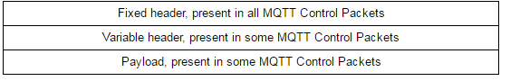
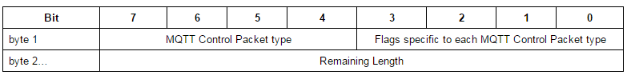
MQTT Control Packet format
Fixed header
Message Type
Flags
Remaining Length
Fixed header
The message header for each MQTT command message contains a fixed header. The table below shows the fixed header format.
Byte 1
Contains the Message Type and Flags (DUP, QoS level, and RETAIN) fields.
Byte 2
(At least one byte) contains the Remaining Length field. The fields are described in the following sections.
All data values are in big-endian order: higher order bytes precede lower order bytes.
A 16-bit word is presented on the wire as Most Significant Byte (MSB), followed by Least Significant Byte (LSB).

Slide 13
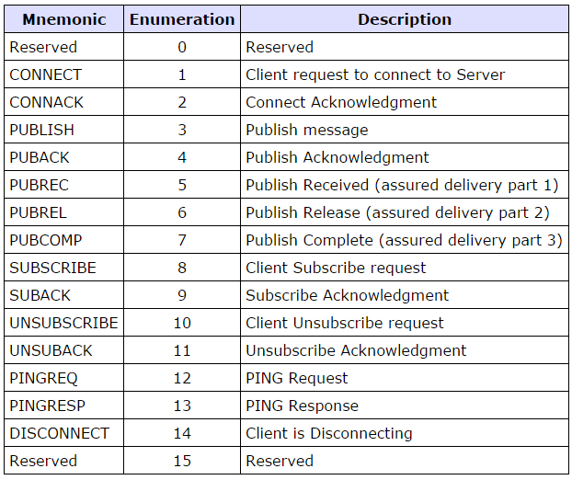
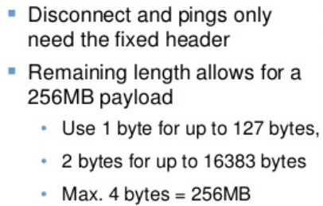
MQTT Control Packet format (cont…)
Fixed header
Message Type
Flags
Remaining Length
Position: byte 1, bits 7-4
The enumerations for this version of the protocol are shown in the table below.

Slide 14
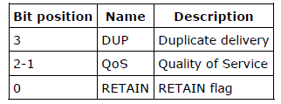
MQTT Control Packet format (cont…)
Fixed header
Message Type
Flags
Remaining Length
The remaining bits of byte 1 contain the fields DUP, QoS, and RETAIN. The bit positions are encoded to represent the flags as shown in the table below.
DUP
Position: byte 1, bit 3.
This flag is set when the client or server attempts to re-deliver a PUBLISH, PUBREL, SUBSCRIBE or UNSUBSCRIBE message
This applies to messages where the value of QoS is greater than zero (0), and an acknowledgment is required.
When the DUP bit is set, the variable header includes a Message ID.
The recipient should treat this flag as a hint as to
whether the message may have been previously received. It should not be relied on to detect duplicates.

Slide 15
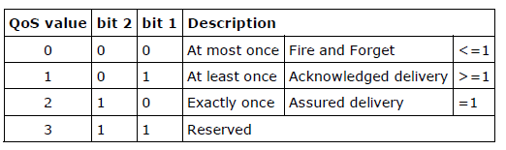
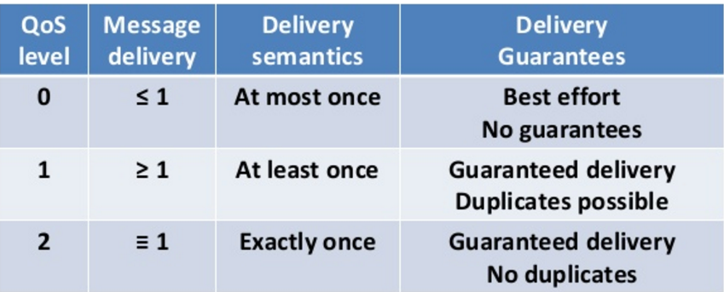
MQTT Control Packet format (cont…)
Fixed header
Message Type
Flags
Remaining Length

Slide 16
MQTT Control Packet format (cont…)
Fixed header
Message Type
Flags
Remaining Length
Position: starts at byte 2.
The Remaining Length is the number of bytes remaining within the current packet,
including data in the variable header and the payload.
The Remaining Length does not include the bytes used to encode the Remaining Length.
The Remaining Length is encoded using a variable length encoding scheme which uses a single byte for values up to 127
Larger values are handled as follows.
The least significant seven bits of each byte encode the data, and the most significant bit is used to indicate that there are following bytes in the representation.
Thus each byte encodes 128 values and a "continuation bit". The maximum number of bytes in the Remaining Length field is four.
Non normative comment.
For example, the number 64 decimal is encoded as a single byte, decimal value 64, hexadecimal 0x40.
The number 321 decimal (= 65 + 2*128) is encoded as two bytes, least significant first.
The first byte 65+128 = 193. Note that the top bit is set to indicate at least one following byte. The second byte is 2.

Slide 17
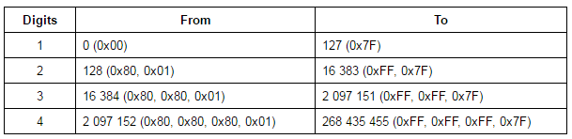
MQTT Control Packet format (cont…)
Fixed header
Message Type
Flags
Remaining Length
Non normative comment.
This allows applications to send Control Packets of size up to 268,435,455 (256 MB).
The representation of this number on the wire is: 0xFF, 0xFF, 0xFF, 0x7F.
The table below shows the Remaining Length values represented by increasing numbers of bytes.

Slide 18
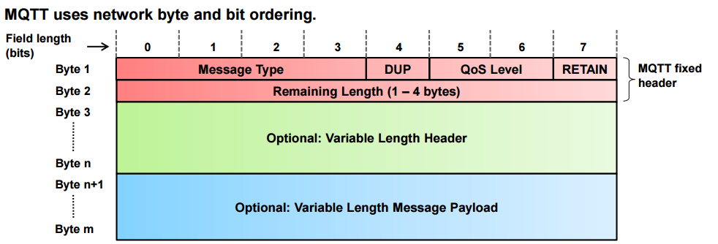
MQTT message format

Slide 19
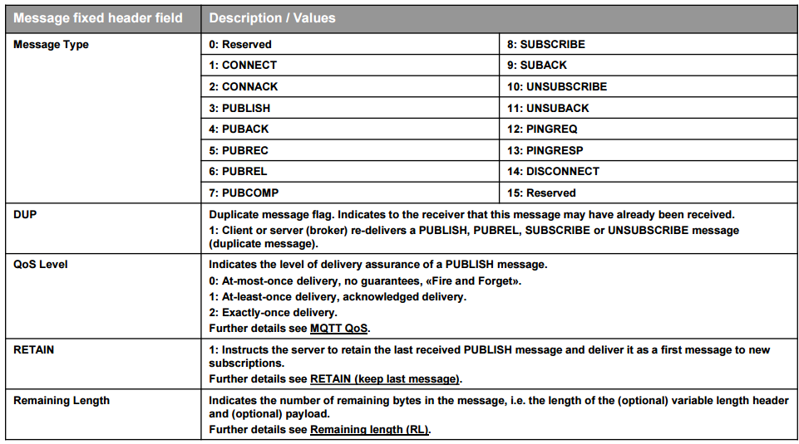
MQTT message format (cont…)

Slide 20
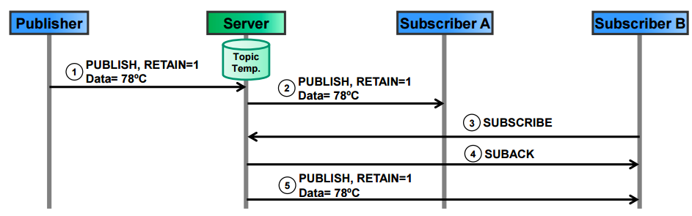
MQTT message format (cont…)
RETAIN (keep last message):
RETAIN=1 in a PUBLISH message instructs the server to keep the message for this topic.
When a new client subscribes to the topic, the server sends the retained message.
Typical application scenarios:
Clients publish only changes in data, so subscribers receive the last known good value.
Example: Subscribers receive last known temperature value from the temperature data topic. RETAIN=1 indicates to subscriber B that the message may have been published some time ago

Slide 21
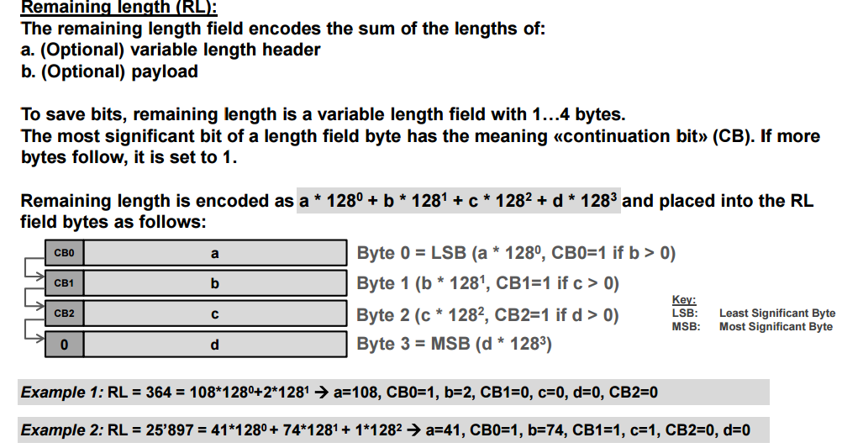
MQTT message format (cont…)

Slide 22
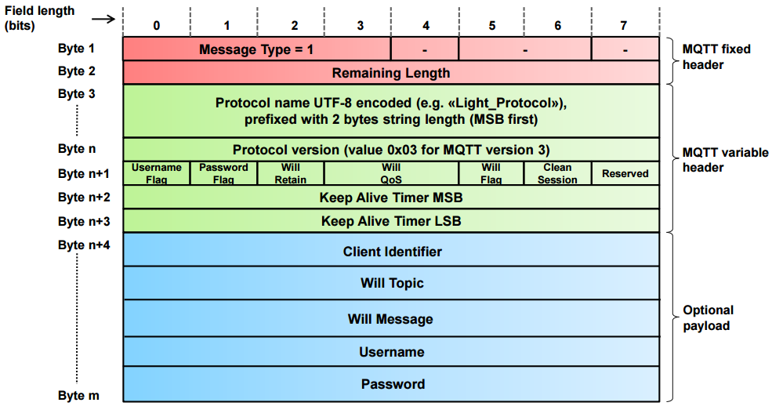
CONNECT message format:
MQTT message format (cont…)
CONNECT | 1 | Client request to connect to Server
The CONNECT message contains many session-related information as optional header fields.

Slide 23
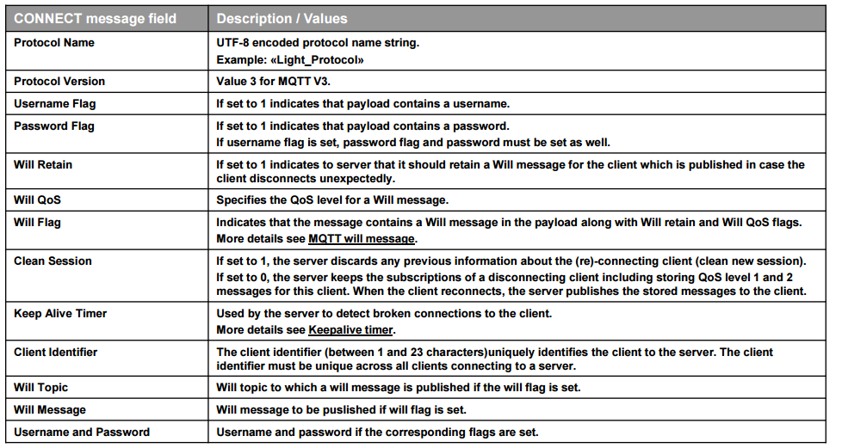
MQTT message format (cont…)
Overview CONNECT message fields:

Slide 24
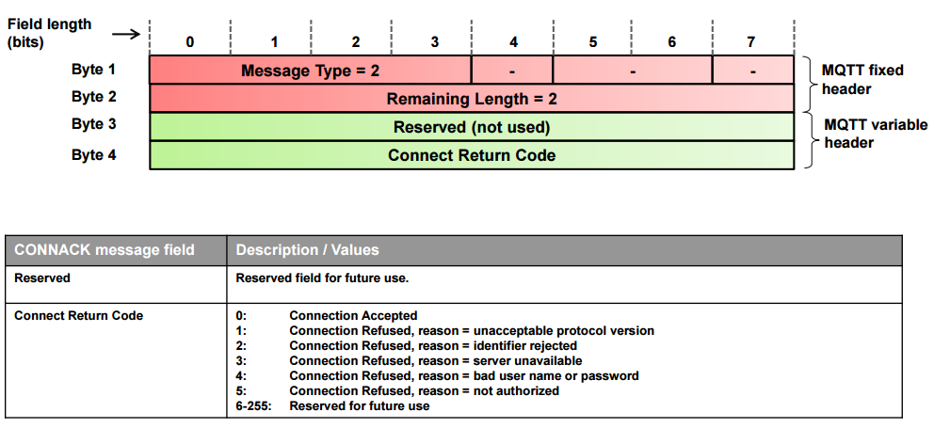
MQTT message format (cont…)
CONNACK message format:
CONNACK | 2 | Connect Acknowledgment

Slide 25
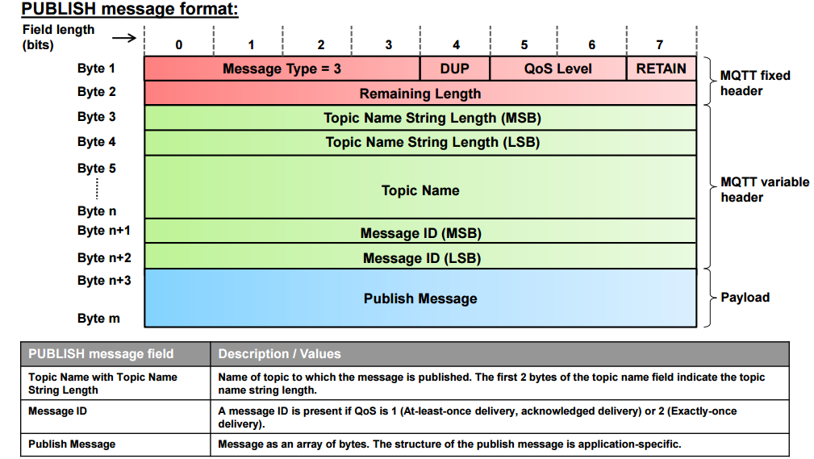
MQTT message format (cont…)
PUBLISH | 3 | Publish message

Slide 26
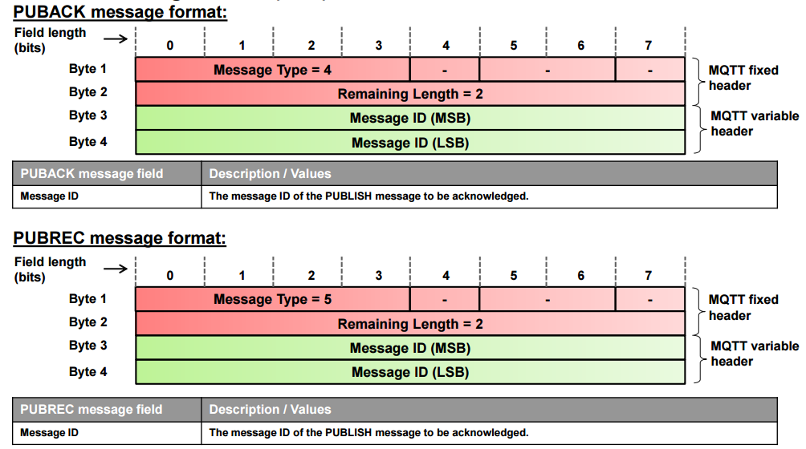
MQTT message format (cont…)
PUBACK | 4 | Publish Acknowledgment
PUBREC | 5 | Publish Received (assured delivery part1)

Slide 27
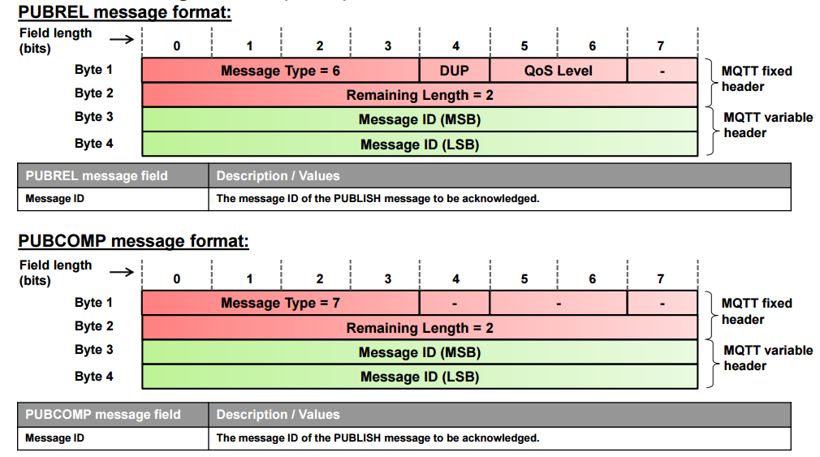
MQTT message format (cont…)
PUBREL | 6 | Publish Release (assured delivery part 2)
PUBCOMP | 7 | Publish Complete (assured delivery part 3 )

Slide 28
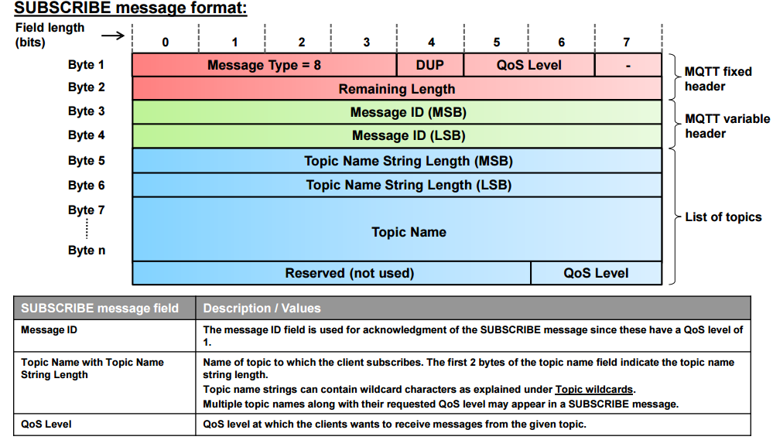
MQTT message format (cont…)
SUBSCRIBE | 8 | Client Subscribe request

Slide 29
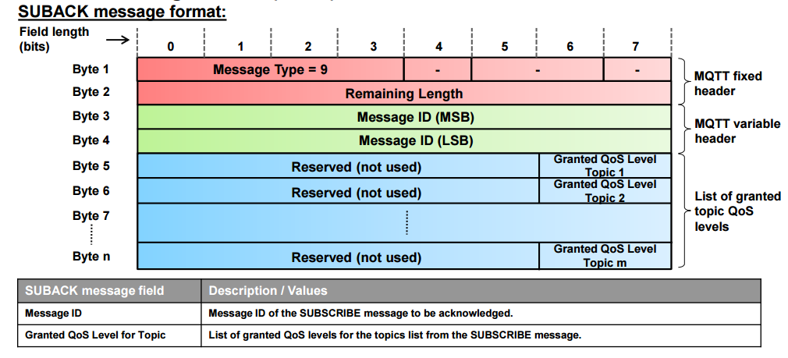
MQTT message format (cont…)
SUBACK | 9 | Subscribe Acknowledgment

Slide 30
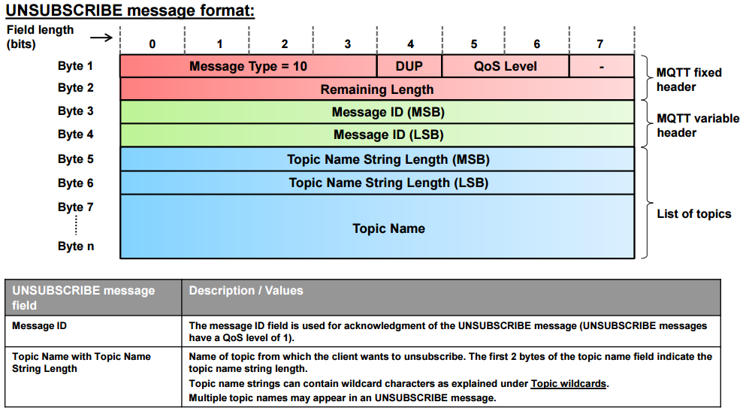
MQTT message format (cont…)
UNSUBSCRIBE | 10 | Client Unsubscribe request

Slide 31
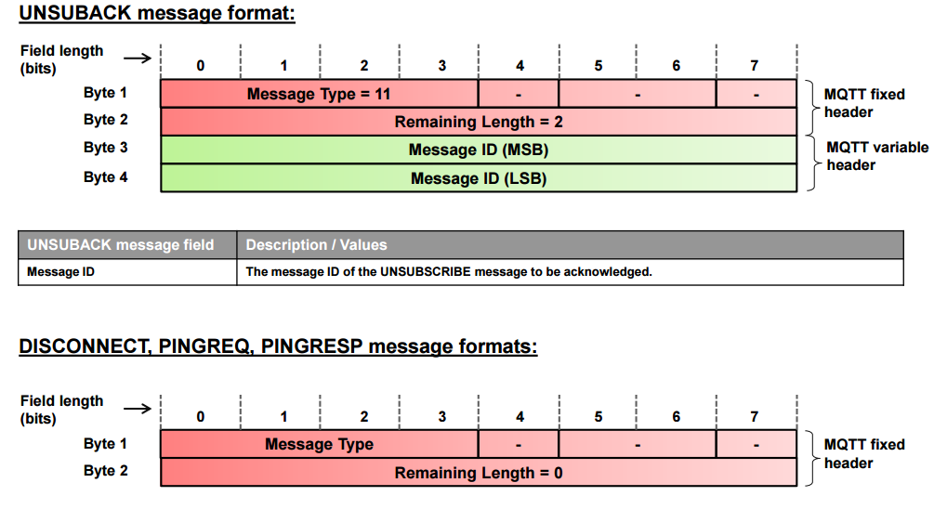
MQTT message format (cont…)
UNSUBACK | 11 | Unsubscribe Acknowledgment
PINGREC | 12 | PING Request
PINGREST | 13 | PING Response
DISCONNECT | 14 | Client is Disconnecting
http://www.slideshare.net/PeterREgli/mq-telemetry-transport

Slide 32
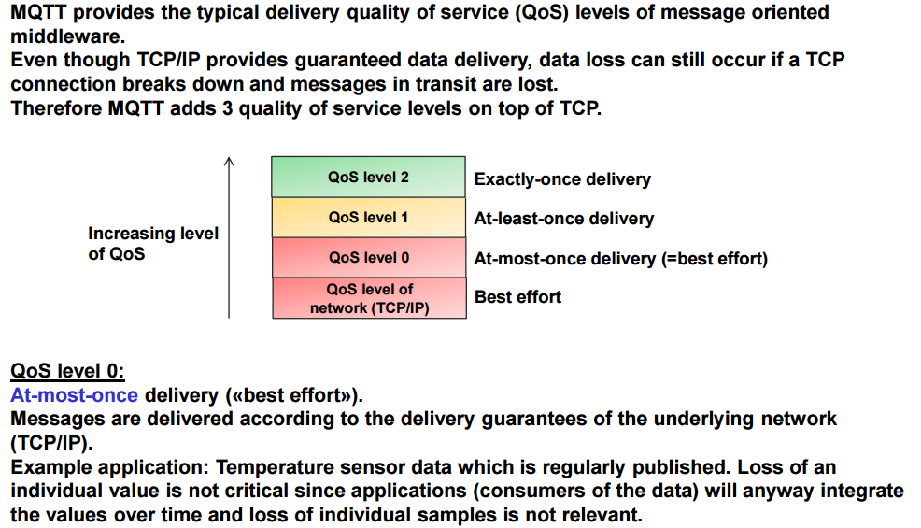
MQTT QoS value
http://www.slideshare.net/PeterREgli/mq-telemetry-transport

Slide 33
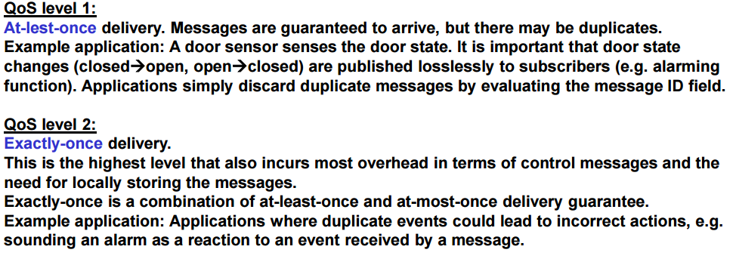
MQTT QoS value (cont…)

Slide 34
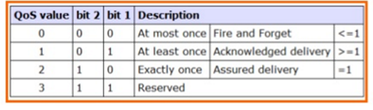
MQTT QoS value (cont…)
http://www.slideshare.net/ragupta2/mqtt-a-protocol-for-the-internet-of-things

Slide 35
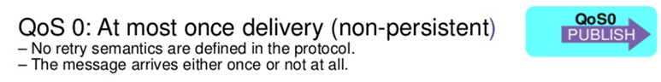
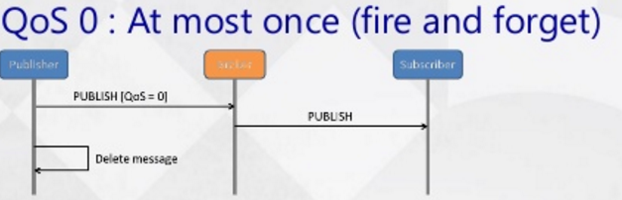
MQTT QoS value (cont….)
"At most once", where messages are delivered according to the best efforts of the underlying TCP/IP network.
Message loss or duplication can occur.
This level could be used, for example, with ambient sensor data where it does not matter if an individual reading is lost as the next one will be published soon after.
http://www.slideshare.net/paolopat/mqtt-iot-protocols-comparison

Slide 36
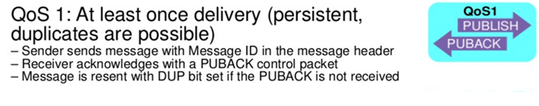
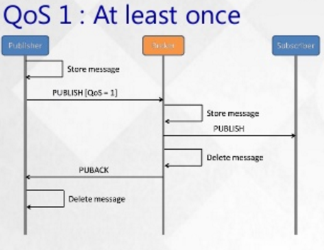
MQTT QoS value (cont…)
"At least once", where messages are assured to arrive but duplicates may occur.
http://www.slideshare.net/paolopat/mqtt-iot-protocols-comparison

Slide 37
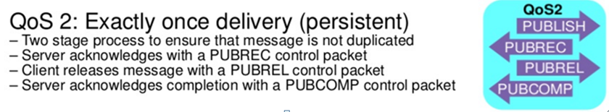
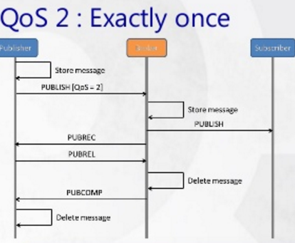
MQTT QoS value (cont…)
"Exactly once", where message are assured to arrive exactly once.
This level could be used, for example, with billing systems where duplicate or lost messages could lead to incorrect charges being applied.
http://www.slideshare.net/paolopat/mqtt-iot-protocols-comparison

Slide 38
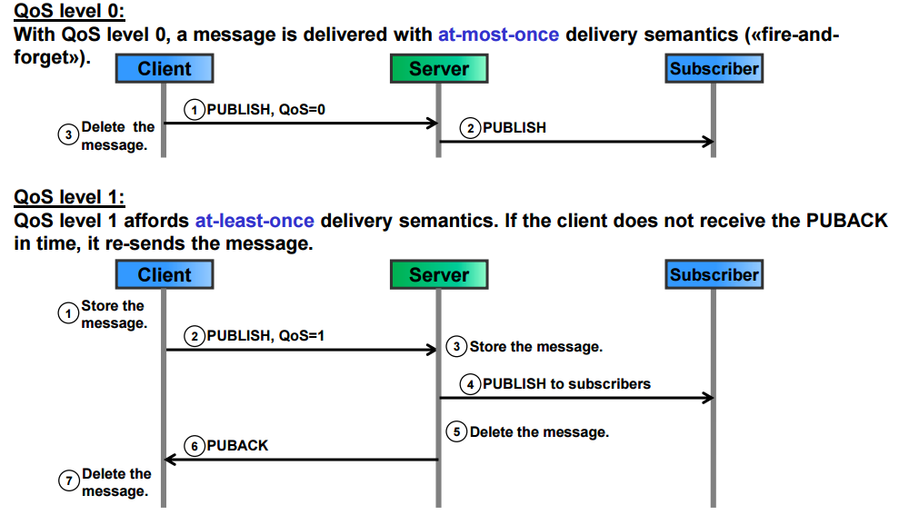
MQTT QoS value (cont…)

Slide 39
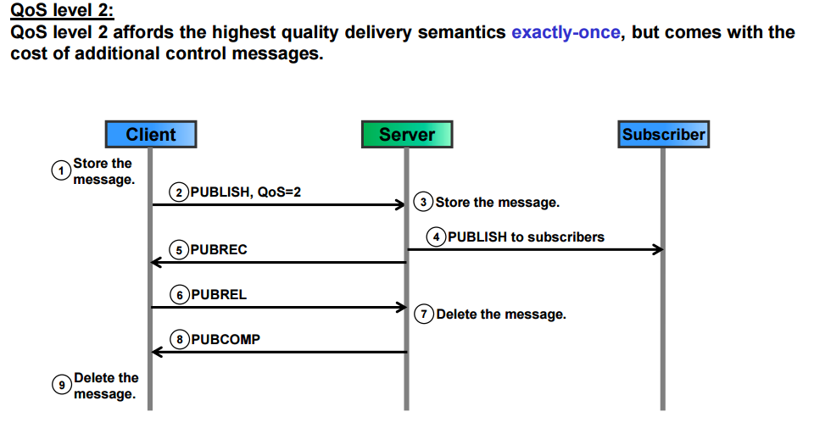
MQTT QoS value (cont…)

Slide 40
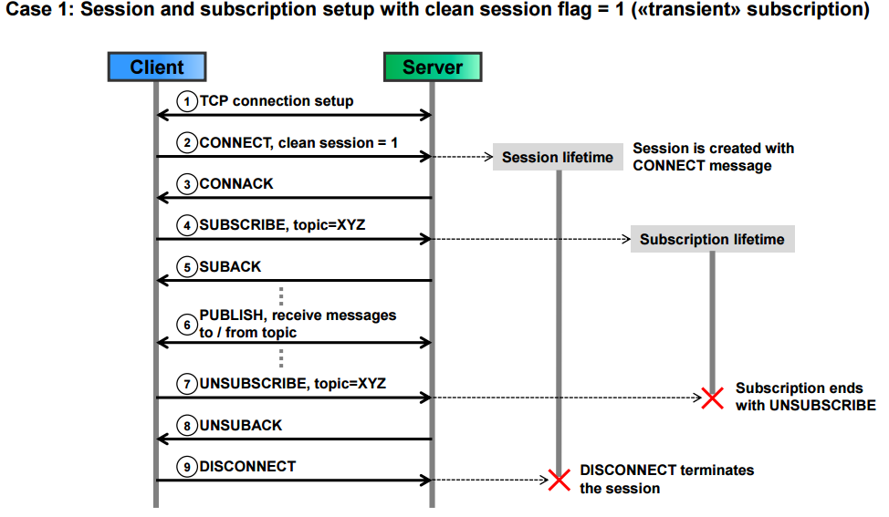
MQTT CONNECT and SUBSCRIBE message sequence

Slide 41
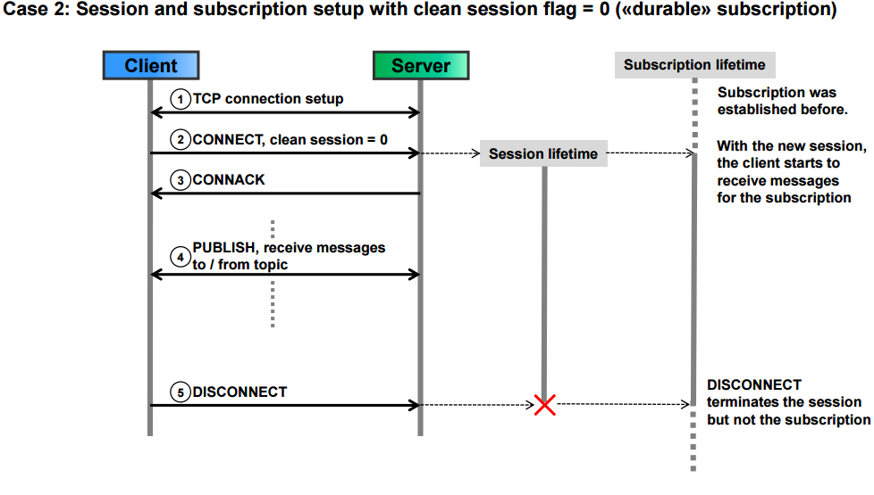
MQTT CONNECT and SUBSCRIBE message sequence (cont…)

Slide 42
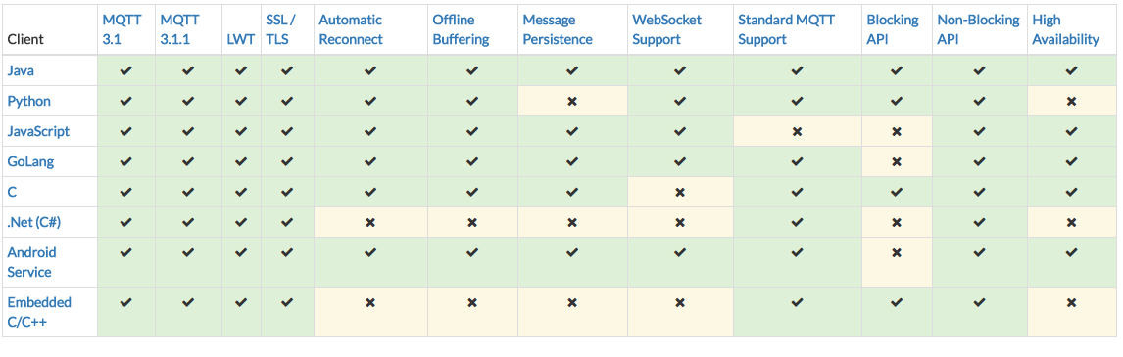
MQTT Client Comparison
http://www.eclipse.org/paho/downloads.php

Slide 43

MQTT Experimental
http://www.eclipse.org/paho/downloads.php

Slide 44

MQTT Stable
http://www.eclipse.org/paho/downloads.php

Slide 45
Thank you!
hamdamboy.urunov@gmal.com

